Slide 1

Automation Framework
C3: Protected

Slide 2

Automation Framework: Objectives
Basics of Automation Framework
CRAFT Framework
Architecture
Script Flow
Folder Structure
Features
Benefits
Challenges in implementation
Notes:
After completing this course you will be able to understand the basics of automation framework and also about Cognizant's automation framework ‘CRAFT’. You will be dealt in detail on the CRAFT’s architecture, the Script Flow, the folder Structure, its features, the benefits and also the challenges in implementing CRAFT.

Slide 3

Basics of Automation Framework
C3: Protected

Slide 4
Basics of Automation Framework - Objectives
Automation Frameworks – An Introduction
Framework Components
Evolution of Automation frameworks
Traditional approach (Record and Playback)
Modular approach
Data driven approach
Keyword driven approach
Hybrid approach
BDD Approach
Page Object Model
Notes:
After completing this chapter you will be able to understand the framework components, different types of Automation Frameworks and features of a good framework.

Slide 5
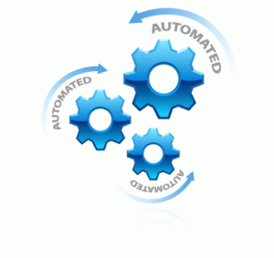
Automation Frameworks – An Introduction
What is Automation Framework?
An Automation Framework is a set of guidelines that you can follow during the “Test script development and maintenance” phase. This set of guidelines can be anything such as –
Specifying the folder structure that will be used for storing test scripts, utility & reusable libraries, object repositories and data sheets.
Deciding the format of data sheets i.e., how the data sheets would be grouped and how the scripts will access these data sheets.
Following proper coding standards and scripting best practices.
Using reusable functions wherever possible so that lesser amount of rework is needed in case of any changes
Utility methods to reduce script development effort (Example: Utility methods to work with test data repository, Object repository, test results reporting, error & exception handling)
Note: Automation framework is not a replacement for any automation tool
Notes:
Suppose you are given a task where you have to automate some functional test cases. When you are done with script development, what would be your expectations from the scripts you have created? Wouldn’t you want that –
The scripts should run as intended without any issues.
The code and the flows should be easy to understand.
The scripts should be easy to maintain in case of any changes in Application Interface.
Should reduce script development effort?
Should contain built in methods for test results reporting, recovery, error & exception handling, integration with test management tool etc.,?
All the above points can be achieved by using a proper Automation Framework.
Note: These are just a set of guidelines and not some rules that should compulsorily be followed. Even if you don’t follow any of these guidelines, you would be able to come up with test scripts that would run perfectly fine. But you might not have the additional advantages like readability of code, ease of maintenance etc.

Slide 6


Features of a good framework
Maximum code reusability
Minimal script maintenance effort
Provision for non-technical users to interact with the framework
Ease of script development – must provide appropriate support libraries to handle common and repetitive framework tasks
Notes:
Here are some of the good features of an automation framework.
Maximum code reusability,
Minimal maintenance effort,
Provision for non-technical users to interact with the framework, in terms of easily driving the test execution, manipulating test data, etc.
The script development should be made easy such that it provides appropriate support libraries to handle common and repetitive framework tasks.

Slide 7
Features of a good framework
Test data externalization – to avoid embedding test data within the scripts
Robust error handling mechanism – to capture any unexpected errors during the test run, without affecting the overall execution
Detailed reporting mechanism – to help in easy analysis of test execution results
Integration with other tools as required (loosely coupled) – for example, QC integration of the framework built
Notes:
It is good to have test data externalization feature in the framework to avoid embedding test data within the scripts. Robust error handling mechanism feature would help to capture any unexpected errors during the test run, without affecting the overall execution. The feature of detailed reporting mechanism helps in easy analysis of test execution results. Integration with other tools as required loosely coupled is also an important feature of an automation framework– for example, QC integration of the framework built for QTP. It is considered as a best practice to use version control and coding standards for the automation framework to enable standardization.

Slide 8
Evolution of automation frameworks
Traditional approach
(Record and Playback)
Modular approach
Data driven approach
Keyword driven approach
Hybrid approach
Notes:
Here is the list of automation frameworks evolved over time.
Linear/ Traditional approach which is Record and Playback,
Modular approach,
Data driven approach,
Keyword driven approach
Hybrid approach

Slide 9
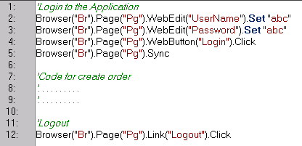


Traditional approach (Record and Playback)
Most test automation tools provide a record and playback feature, which allows you to record all the user actions associated with the test case, and generate the corresponding test scripts automatically.
Pros:
Minimal technical knowledge required
Fastest and easiest way to create test scripts
Understanding scenario flow is very
easy as the scripts are written in a linear manner
Cons:
Each test case has its own local object repository.
Any branching conditions/loops cannot be recorded, needs to be manually inserted
Scripts are difficult & expensive to maintain, highly sensitive to UI changes
Reuse of code is less, which leads to bulky test scripts and redundancy
Test data is hard-coded within the scripts. The same test script cannot be executed with multiple test data variations.
Unsuitable for most real-time automation projects
The only way to reuse the code will be to copy paste it in different test cases which leads to code duplication
Notes:
Traditional approach. Most test automation tools provide record and playback feature, which allows you to record all the user actions associated with the test case, and generate the corresponding test scripts automatically.
Some of the advantages of this approach are
The ease of use, the minimal technical knowledge required and the rapid script development
The disadvantages of this approach are any branching conditions or loops cannot be recorded and have to be manually inserted. Scripts are difficult and expensive to maintain, as they are highly sensitive to UI changes. The reuse of code is less, which leads to bulky test scripts and redundancy. In this approach the test data is hard-coded within the scripts and hence it is unsuitable for most real-time automation projects.
The only way to reuse the code will be to copy paste it in different test cases which leads to code duplication

Slide 10
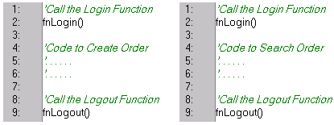
Modular approach
Modular Framework is the approach where all the test cases are first analyzed to find out the reusable flows/steps. Then while scripting, all these reusable flows are created as functions and stored in external files and called in the test scripts wherever required. These functions can then be called from multiple scripts as required.
Pros:
Test scripts can be created in relatively less time
The reusable methods/functions need to be created only once
Effort required to create test cases is also lesser due to code reuse
If there are any changes in the reusable functions, the changes need to be done in only a single place. Hence script maintenance is easier
Cons/ Dependencies:
Since the test data is still hardcoded in the script/ functions, the same test script cannot handle multiple test data variations
Good programming knowledge is required to create and maintain function libraries
Lot of planning is required up-front to analyze the test cases and break them up into reusable functions
Notes:
Modular approach. Modular approach automation framework involves identifying the reusable code and encapsulating the same into functions in external libraries. These functions can then be called from multiple scripts as required.
The advantages of this approach are it promotes the reusability of code, helps in reducing the maintenance effort by minimizing duplication of rework effort. It is also reasonably simple to implement than the traditional approach.
The disadvantages of this approach are test data is hard coded within the scripts/functions and this approach does not provide features for non technical business users to interact with the framework.

Slide 11
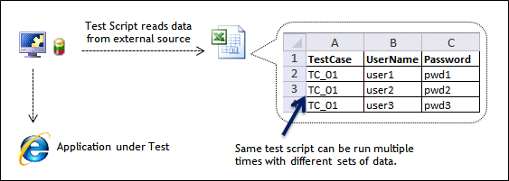
Data driven approach
In Data Driven Framework, the data is NOT hard-coded in the test scripts. Instead, it is stored in some external files. (Excel sheet; Databases, XML files or other data sources). The test script first connects to the external data source and then extracts the data from that source.
Pros:
Avoids hard-coding of test data in the scripts
Non-technical users can easily change the test data using the Excel sheets, without modifying the scripts in any way
The same script can be executed multiple times with different sets of data
Changes made in the test data don’t affect the test scripts in any way and vice versa
Dependencies:
Additional effort and good technical expertise needed to create functions that connect to the external data sources to retrieve the test data
Additional effort needed to select right external data source and to decide how the data should be stored or grouped in that external data source.
Notes:
Data driven approach advocates externalizing the test data from the test automation tool to improve the maintainability of data to be used in the test cases. Test data are generally externalized into an Excel sheet., Databases, XML files or other data sources may be used as well. This improves the maintainability of test data.
Here are some of the advantages of this approach . Data driven approach avoids hard-coding of test data in the scripts. Non-technical users can easily change the test data using the Excel sheets, without modifying the scripts in any way. The same script can easily be executed with multiple rows of test data. This approach is reasonably simple to implement too.
But the main disadvantages of this approach are:
Additional effort and good technical expertise is required to create functions that connect to the external data sources to retrieve the data
Additional effort needed to select right external data source and to decide how the data should be stored or grouped in that external data source.

Slide 12
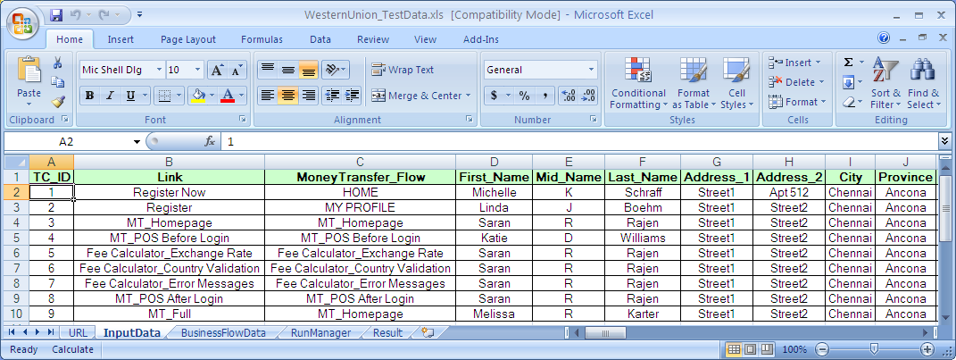
Data driven approach Contd..
A sample Excel sheet showing test data externalization
Notes:
This sample excel sheet shows an externalized set of test data in a Data Driven framework. In this sheet various columns represent the data to be used in the test cases during the test execution.

Slide 13
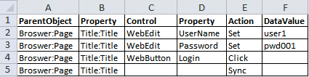
Keyword driven approach
In Keyword Driven framework, you can create various keywords and associate a different action or function with each of these keywords. Then you create a Function Library that contains the logic to read the keywords and call the associated action
Keyword driven frameworks come in many different flavors.
Action Keyword Driven Approach (Low level keywords)
Business keyword driven approach (High level keywords)
Components of Key word driven framework
Data Table or Excel Sheets which contains the keywords and the steps needed to execute a particular flow or action
A Function Library which contains various functions that read each line from the excel sheet, convert it into “Automation Tool readable” format and finally execute it.
Object Repository may or may not be used in this framework. You can use descriptive programming approach/ Page object model if you want to avoid using the object repository
Notes:
Keyword driven approach uses a set of custom keywords to depict a user action or a set of user actions. Sometimes it is also called table-driven approach. Excel sheets are typically used to specify the keywords (In rare cases databases too).
This approach can be further subdivided into two. One, Action Keyword driven approach or Low-level keywords. This facility is available in-built in the QTP tool. And second is business Keyword driven approach or High-level keywords.

Slide 14
Action Keyword driven approach (Low-level)
A keyword represents a single basic user action, like clicking on a button, typing text in a textbox, etc.
Helps non-technical users to build the scripts easily without any programming knowledge.
E.g.: ButtonClick, TypeText, etc.
Pros:
The keyword and function libraries are completely generic and thus can be reused easily for different applications.
All the complexity is added in the function libraries. Once the libraries are ready, it becomes very easy to write the actual test script steps in excel sheets
Readability of the scripts is very high
Wrapper functions may be written around all the basic functions, to include additional validations and reporting. E.g.: We may want to check whether a button exists before clicking it (validation), and in case of any error, we may want to generate a custom error message (reporting).
Notes:
In Action Keyword driven approach, a keyword represents a single basic user action, like clicking on a button, typing text in a textbox, etc. Hence, these are basically low-level keywords.
This approach helps non-technical users to build the scripts easily without any programming knowledge. In fact, there is no actual scripting involved and the automation would be entirely driven from Excel/Database. E.g.: ButtonClick, TypeText, etc.
Advantages of this approach are:
Scripts can be created without any programming knowledge
Readability of the scripts is very high
Wrapper functions may be written around all the basic functions, to include additional validations and reporting.
For example, we may want to check whether a button exists before clicking it , that is, validation and in case of any error we may want to generate a custom error message, that is reporting.

Slide 15
Action Keyword driven approach (Low-level)
Cons:
Any branching conditions/loops cannot be directly represented by keywords, and have to be separately implemented as external functions
“Scripts” are difficult & expensive to maintain, highly sensitive to UI changes
Tedious to create functions/keywords to cover all the possible user actions
Need to extend the functions/keywords for various environments like Web, Windows, Java, etc
Creating wrapper functions around each of the user actions has adverse effect on the overall speed of the script
Implementation effort is quite high and Debugging can be very tough
High programming skills are needed to create the complex keyword library functions
Lot of time and effort needed initially to create the function libraries.
Notes:
Lets see some of the disadvantages of action keyword driven approach.
Any branching conditions or loops cannot be directly represented by keywords and have to be separately implemented as external functions. The “scripts” are difficult & expensive to maintain, as they are highly sensitive to UI changes. It is very tedious to create functions/keywords to cover all the possible user actions. We need to extend the functions/keywords for various environments like Web, Windows, Java, etc. Creating wrapper functions around each of the user actions will have an adverse effect on the overall speed of the script. Implementation effort is quite high. Debugging can be very tough.

Slide 16
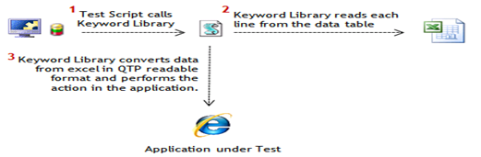
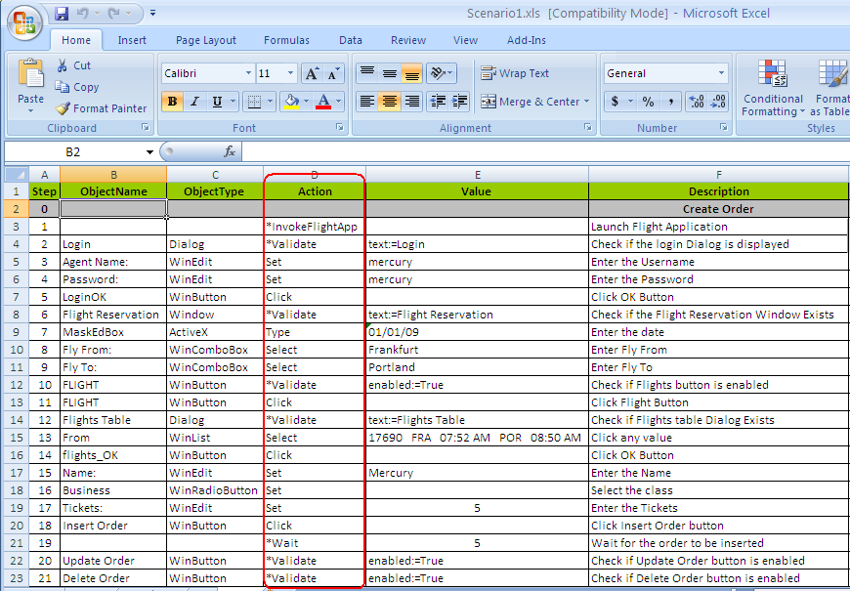
Action Keyword driven approach (Low-level)
Action Keyword driven approach (Low-level keywords)
Notes:
The sample excel sheet here shows a typical low level keyword driven automation framework. The column ‘D’ titled as Action depicts the low level keywords in the framework. The code for the keywords are already written using the automation tool and the library of keywords are provided to the testers to build the automation test cases. The other columns provide additional kind of information to the test tool to allow execution like Object Name, Object type and the value to be used.

Slide 17
Business Keyword driven approach (High - level)
An extension of the modular approach.
All the test cases are split up into smaller components, with the aim of reusing these components in multiple test cases.
Each component is represented by a keyword, i.e., a keyword depicts a series of user actions.
E.g.: Login, Create_Insurance_Policy, Deposit_Cash_In_Account, etc.
Designed to facilitate a seamless interaction between Business Analysts (domain/functional experts) and the QA engineers (automation experts)
Notes:
Business Keyword driven approach. Business Keyword driven approach or High-level keywords is an extension of the modular approach. In this approach, all the test cases are split up into smaller components, with the aim of reusing these components in multiple test cases. Each component is represented by a keyword, that is, a keyword depicts a series of business flows. Hence, these are basically high-level keywords, which is in contrast to the Action keywords discussed in the previous section. Example: Login, Create_Insurance_Policy, Deposit_Cash_In_Account, etc. This approach is designed to facilitate a seamless interaction between Business Analysts (domain/functional experts) and the QA engineers (automation experts)

Slide 18
Business Keyword driven approach (High - level)
Pros:
Very high degree of maintainability of scripts
Promotes reusability of scripts
Abstraction of technical complexities from business users
Usage of keywords provides easy traceability of the degree of reuse of the business components
Cons:
It may not be possible to reuse all the business components
Lot of planning is required up-front to analyze the test cases and break them up into reusable business components
Involves some amount of implementation effort, though not as much as required for the Action keyword driven approach
Notes:
The advantages of business keyword driven approach are it provides very high degree of maintainability of scripts, promotes reusability of scripts, abstraction of technical complexities from business users, usage of keywords provides easy traceability of the degree of reuse of the business components.
The disadvantages of this approach are it may not be possible to reuse all the business components. Lot of planning is required up-front to analyze the test cases and break them up into reusable business components. It involves some amount of implementation , though not as much as required for the Action keyword driven approach.

Slide 19
Hybrid approach
Hybrid Framework is a framework that is created by combining different features of any of the frameworks mentioned above. Based on the requirements, you can combine the features of any of the above frameworks to come up with your own version of Hybrid Framework
Most automation frameworks today have evolved into hybrid approaches, combining the best practices from all of the above frameworks.
The keyword and data driven approaches are commonly used together.
For example, the CRAFT framework is a hybrid of the Business keyword driven approach and the data driven approach (Optionally, the Action keyword driven approach may be integrated as well).
Some simpler frameworks like CRAFTLite combine the modular and data driven framework.
Notes:
Hybrid Test Automation Framework is the most commonly implemented framework and is a combination of all of the above techniques, pulling from their strengths and trying to mitigate their weaknesses.
The keyword and data driven frameworks are commonly used together. This allows data driven scripts to take advantage of the powerful libraries and utilities that usually accompany a keyword driven architecture
For example, the CRAFT framework is a hybrid of the Business keyword driven approach and the data driven approach. Optionally, the Action keyword driven approach may be integrated as well. Some simpler frameworks like CRAFTLite combine the modular and data driven approaches. To sum up, hybrid frameworks aim to combine the advantages of multiple approaches, and are generally the most preferred type of automation framework.

Slide 20
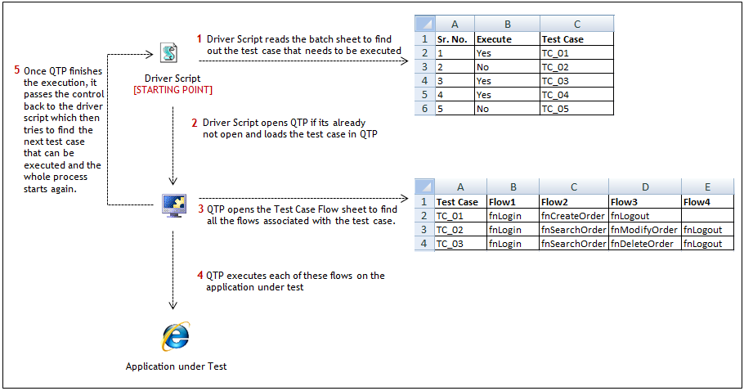
Components of Hybrid Framework
An Example with HP UFT/ QTP
Test Data
Other common components like Function Libraries, Data Sheets, Object Repositories, Configuration files etc are also a part of Hybrid Framework.
Notes:
Advantages of Hybrid Automation Framework:
The main advantage of this approach is that you can use the best features from all the types of frameworks to create your own
Disadvantages:
The framework is highly complex and needs very good programming expertise and experience to build a Hybrid Framework from scratch.

Slide 21
Business Process Testing (BPT) framework in HP UFT/ QTP
Business Process Testing (BPT) Framework is the framework where you can divide the test cases into multiple flows and each of these flows is scripted by using a Business Process Component. When all the components for a particular test case are ready, you can link the components one after the other as per the test case flow and execute the BPT test case from QC.
Components in BPT Framework
Application Area: Application Area acts as a container or a place holder that stores the Business Process Components and other related items such as function libraries, object repositories etc.
Business Process Component: Just like functions or actions that can be used to store re-usable code, BPT framework has Business Process Components in which you write the scripts for an action.
Above mentioned are the two components that are available specifically in BPT Framework. Other than these, you will have the standard components like function libraries, object repositories, data sheets etc as part of your BPT Framework.

Slide 22
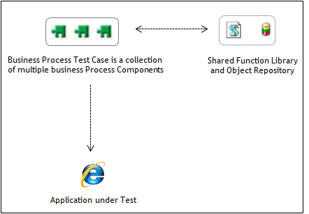
Business Process Testing (BPT) framework in HP UFT/ QTP (Cont.,)
Pros:
BPT Framework allows non-technical subject matter experts to quickly create test cases using the business process components.
A lot of features such as component linking & data parameterization come built in with the BPT Framework. Because of this you do not need to spend extra effort to write code for these functionalities.
Cons:
BPT Framework can be used only if you have QC/ALM access
You would need to purchase additional license for BPT Framework if you want to use this for your test scripts.
Results in high script execution time as and when the components grows

Slide 23
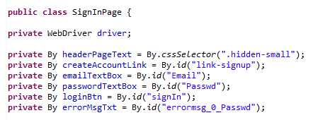

Page Object Model
Page Object Model is a design pattern to create Object Repository for web UI elements.
Under this model, for each web page in the application there should be corresponding page class.
This Page class will find the WebElements of that web page and also contains Page methods which perform operations on those WebElements.
The main advantage of Page Object Model is that if the UI changes for any page, it doesn’t require to change any tests, we just need to change only the code within the page objects (Only at one place). Page object model can be implemented with tools like selenium, UFT, watir, watin, BDD with specflow or cucumber etc..
An Example with Selenium
Pros:
There is clean separation between test code and page specific code such as locators (or their use if you’re using a UI map) and layout
There is single repository for the services or operations offered by the page rather than having these services scattered through out the tests.
Easy test maintenance and reduces the duplication of code.
Notes:
In the above screen shot, we have first identified the locators and defined it on the top after the class. In this way we can achieve readability of test scripts and we can easily identify locators and change them if needed at only one place.
Page Object model is writing all the functionalities / reusable components of a page that we want to automate in a separate class. Say now if we consider four pages as Home page, Login page, Create Account and Forgot password page etc.
Advantages:
There is clean separation between test code and page specific code such as locators (or their use if you’re using a UI map) and layout
There is single repository for the services or operations offered by the page rather than having these services scattered through out the tests.
Dependencies:
High programming skills/ expertise needed to work with page object model
Lot of planning needed upfront to categorize different pages and related, common controls

Slide 24

Automation Frameworks - Summary
The importance of automation frameworks cannot be undermined.
Frameworks are an essential part of any automation project, and a thorough knowledge of these is a necessity for every automation tester.
It is important to note that there is no one framework that solves all automation problems.
The decision on the type of framework to be used has to be taken after careful analysis of the automation requirements, and with sound understanding of the pros and cons of each framework.
Notes:
Summary. Here is a quick summary of what we discussed in this chapter so far. The importance of automation frameworks cannot be undermined.
Frameworks are an essential part of any automation project, and a thorough knowledge of these is a necessity for every automation tester.
It is important to note that there is no one framework that solves all automation problems.
The decision on the type of framework to be used has to be taken after careful analysis of the automation requirements, and with sound understanding of the pros and cons of each of framework.

Slide 25
CRAFT Framework
C3: Protected

Slide 26
CRAFT Framework - Objectives
Components of CRAFT
Architecture of CRAFT
Role played by each component
Script Flow
Folder Structure
Features
Benefits
Challenges in implementing CRAFT
Notes:
After completing this chapter, you will be able to Understand the craft Framework, components of craft, its architecture and the role played by each component in the framework. You will also learn about craft Script Flow, the folder Structure, the features and benefits of CRAFT and also the challenges in implementing CRAFT

Slide 27
CRAFT Framework
Follows a hybrid-driven approach, combining the best practices of both keyword-driven and data-driven approaches.
Also tool agnostic, which means that the C.R.A.F.T design principles may be implemented over any automation tool like HP UFT, CodedUI, Selenium, Ranorex, etc.
The core logic of CRAFT involves breaking down the test cases into components.
The basic idea is to reuse components across test cases, thereby minimizing redundancies in script design.
CRAFT - Cognizant Reusable Automation Framework for Testing . Cognizant’s in-house automation framework, proposed to ease the script development and maintenance effort in test automation.
Notes:
CRAFT Framework. CRAFT means Cognizant Reusable Automation Framework for Testing. It is Cognizant’s in-house automation framework, proposed to ease the script development and maintenance effort in test automation. It follows a hybrid-driven approach, combining the best practices of both keyword-driven and data-driven approaches. It is also tool agnostic, which means that the C.R.A.F.T design principles may be implemented over any automation tool like HP UFT, CodedUI, Selenium, Ranorex, etc. The core logic of CRAFT involves breaking down the test cases into components. This would be typically done by a subject matter expert, after analyzing the test cases appropriately. Once the componentization is done, test cases can be easily created by dragging together the required components. The basic idea is to reuse components across test cases, thereby minimizing redundancies in script design.

Slide 28







CRAFT Framework Architecture
Schematic representation of C.R.A.F.T
Run Manager.xls
<Batch Configuration>
<Test case details>
Reusable Libraries
Init Script
<Batch Execution>
Customized
Test
Results
<HTML, Excel>
Recovery Libraries
<Error handling
functions>
<Test case details>
Driver Script
<Brain of the framework>
Data Engine
<Hybrid Driven>
Support Libraries
<Application
independent
reusable functions>
Business Flow
<Keyword Driven>
Test Data
<Data Driven>
Business Components
<Building blocks of test cases>
Notes:
This is a schematic representation of CRAFT framework show casing the various components of it. Each of these components are explained in the forthcoming slides.

Slide 29
CRAFT Framework
Business Components
First step in creating automation scripts
Used to build the library consisting of reusable business components.
Inputs may be taken from a domain expert who is familiar with the test cases to help identify these reusable components. Once identified, the components are scripted using the test automation tool, stored in the library and documented for future reference.
Data Engine
Data Engine is at the heart of the C.R.A.F.T framework. It is usually implemented in MS Excel, for ease of maintenance. The Data Engine symbolizes the hybrid-driven approach of C.R.A.F.T
Business Components
<Building blocks of test cases>
Data Engine
<Hybrid Driven>
Business Flow
<Keyword Driven>
Test Data
<Data Driven>
Notes:
Business Components
The first step in creating automation scripts using this approach is to build the library consisting of reusable business components.
Inputs may be taken from a domain expert who is familiar with the test cases to help identify these reusable components. Once identified, the components are scripted using the test automation tool, stored in the library and documented for future reference.
Data Engine
The Data Engine is at the heart of the CRAFT framework. It is usually implemented in MS Excel, for ease of maintenance. The Data Engine symbolizes the hybrid-driven approach of CRAFT.

Slide 30
CRAFT Framework
Support Libraries
<Application
independent
reusable functions>
Support Libraries
Fully reusable functions that are tool-specific and independent of the AUT. Includes functions for page navigation and navigation verification, date manipulation, sending mails, updating databases, file output and so on
Driver Script
Brain of the C.R.A.F.T. Framework. Traverses through the business flow data and calls the respective business components one by one.
It not only takes care of executing the test case across all the test data iterations but is also responsible for generating the test reports at the end of test execution.
Recovery Libraries
In-built error handling functions available in CRAFT
Error handling is one of the most important features of CRAFT. It ensures that the script execution runs uninterrupted under all circumstances.
Driver Script
<Brain of the framework>
Recovery Libraries
<Error handling
functions>
Notes:
Support Libraries
These are fully reusable functions that are tool-specific and independent of the AUT. They include functions for page navigation and navigation verification, date manipulation, sending mails, updating databases, file output and so on
Driver Script
Driver script is the brain of the CRAFT Framework. It traverses through the business flow data and calls the respective business components one by one.
It not only takes care of executing the test case across all the test data iterations but is also responsible for generating the test reports at the end of test execution. It is a generic script, which can be used across all projects with minimum changes.
Recovery Libraries
These are the in-built error handling functions available in C.R.A.F.T. Error handling is one of the most important features of C.R.A.F.T. It ensures that the script execution runs uninterrupted under all circumstances

Slide 31
CRAFT Framework
Customized
Test
Results
<HTML, Excel>
Customized Test Results
Provides customized test reports, apart from the regular result files
generated by QTP. The customized results are available in Excel and HTML
formats, and are generated with the help of the support functions.
Run Manager and Initialization script
Used to facilitate the batch execution of multiple test cases.
The Run Manager is an Excel sheet which allows users to
control which are the test cases to be executed at a particular point of time.
C.R.A.F.T advocates grouping together of related test cases into test scenarios or test modules for easy maintenance.
The Run Manager usually has separate sheets for the different scenarios/modules, to provide a better control over the execution.
Run Manager.xls
<Batch Configuration>
<Test case details>
Init Script
<Batch Execution>
Notes:
Customized Test Results. One of the key differentiators in CRAFT is the provision to provide customized test reports, apart from the regular result files generated by QTP. The customized results are available in Excel and HTML formats, and are generated with the help of the support functions.
Run Manager and Initialization script. These are used to facilitate the batch execution of multiple test cases. The Run Manager is an Excel sheet which allows users to control which are the test cases to be executed at a particular point of time. CRAFT advocates grouping together of related test cases into test scenarios or test modules for easy maintenance. The Run Manager usually has separate sheets for the different scenarios/modules, to provide a better control over the execution.

Slide 32
CRAFT Script Flow
User double clicks the Initialization script to trigger the execution.
The Initialization script opens HP UFT/ QTP and invokes the Driver script.
The Initialization script reads the Run Manager sheet, finds the first test case which is flagged as “TRUE”, and passes the details of the test case to be executed to the Driver Script.
The Driver Script reads the Business flow data of the test case received and transfers control to the corresponding business component.
The business component takes over and executes its flow, using the test data from the datatable.
Control then returns to the Driver Script, and steps 4, 5 are repeated till the business flow of the test case is completed.
Once the test case is executed, the flow goes back to step 3, and the cycle continues till all the test cases flagged as “TRUE” are executed.
The Support/Recovery libraries may be accessed by both the Driver Script and the Business Components, as and when required.
At the end of the execution, the Driver Script publishes the customized test results.
Run Manager.xls
<Batch Configuration>
<Test case details>
Reusable Libraries
Init Script
<Batch Execution>
Customized
Test
Results
<HTML, Excel>
Recovery Libraries
<Error handling
functions>
<Test case details>
Driver Script
<Brain of the framework>
Data Engine
<Hybrid Driven>
Support Libraries
<Application
independent
reusable functions>
Business Flow
<Keyword Driven>
Test Data
<Data Driven>
Business Components
<Building blocks of test cases>
Notes:
The script flow of craft takes place in the following sequence.
The user double clicks the Initialization script to trigger the execution.
The Initialization script opens HP UFT/ QTP and invokes the Driver script.
The Initialization script reads the Run Manager sheet, finds the first test case which is flagged as “TRUE”, and passes the details of the test case to be executed to the Driver Script.
The Driver Script reads the Business flow data of the test case received and transfers control to the corresponding business component.
The business component takes over and executes its flow, using the test data from the data table.
Control then returns to the Driver Script, and steps 4, 5 are repeated till the business flow of the test case is completed.
Once the test case is executed, the flow goes back to step 3, and the cycle continues till all the test cases flagged as “TRUE” are executed.
The Support/Recovery libraries may be accessed by both the Driver Script and the Business Components, as and when required.
At the end of the execution, the Driver Script publishes the customized test results.

Slide 33
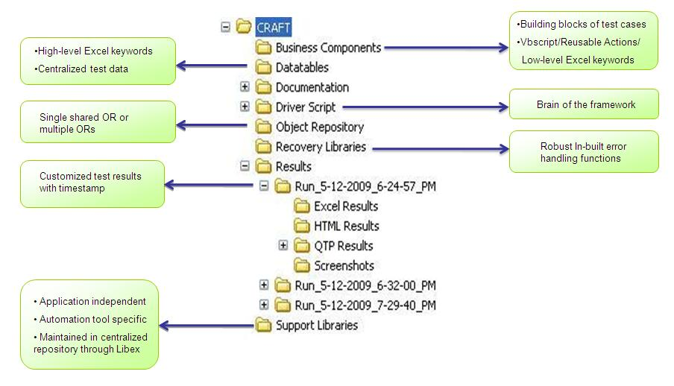
CRAFT Folder Structure
A sample folder structure for the framework is depicted below (QTP implementation is assumed here):
Notes:
This is the sample folder structure of the CRAFT framework with QTP used as the automation tool of choice.

Slide 34
CRAFT Folder Structure
Folder | Contents
Business Components | Contains the reusable business components which are the building blocks of test cases.
Datatables | Contains the hybrid-driven data component of C.R.A.F.T in the form of Excel sheets.
Documentation | Contains relevant documentation for the framework, as well as any additional artifacts required.
Driver Script | Contains the Driver script.
Object Repository | Contains the object repository of QTP. It may contain either a single shared repository or multiple repositories if required.
Recovery Libraries | Contains the in-built error handling libraries of CRAFT. Recovery scenarios are also placed here.
Results | Contains the customized test results in Excel and HTML formats.
Support Libraries | Contains the support libraries.
Notes:
The different folders and its contents are explained here.
Business Components contains the building block of test cases, reusable actions/functions as well as low level excel keywords.
Data Table contains the hybrid driven data component of CRAFT in the form of Excel sheets having both High level keywords as well as test data.
Documentation folder contains relevant documentation for the framework, as well as any additional artifacts required.
Driver script consists of the main script driving the entire framework.
Object Repository contains the tool’s object repository.
Recovery Library consists of the inbuilt error handling functions which can be extended based on the requirement.
Results folder consist of customized test results in Excel, HTML and tool specific format along with screen shots. Individual folders are named along with timestamp for easy tracking.
Support libraries consist of reusable function libraries which can be used across applications independent of technology too.

Slide 35
CRAFT Benefits
Effective BA-QA interaction
Business components ensure increased reusability of scripts
Minimal script maintenance effort
Enables business users to drive the automation easily
Custom results can be easily shared and analyzed by business users
Significant cost savings in the long run
Notes:
Here are the benefits of implementing CRAFT. Effective BA-QA interaction, Business components ensure increased reusability of scripts, Minimal script maintenance effort, Enables business users to drive the automation easily, Custom results can be easily shared and analyzed by business users, Significant cost savings in the long run.

Slide 36
Challenges in implementing CRAFT
Additional startup time
Identifying the reusable business components
Managing large Object Repository
Additional startup time
Identifying reusable business components
Managing large Object Repository
Notes:
The challenges in implementing CRAFT are additional startup time, identifying the reusable business components and Managing large Object Repository.

Slide 37
Summary
Basics of Automation Frameworks
Features of a good framework
Evolution of automation frameworks
Traditional approach (Record and Playback)
Modular approach
Data driven approach
Keyword driven approach
Hybrid approach
CRAFT Framework
C.R.A.F.T Architecture, Script Flow, Folder Structure, Features, Benefits, Challenges in implementing CRAFT
Notes:
In this course you have learnt about the Basics of Automation Frameworks, features of a good framework, how the automation framework evolved, and about the craft framework.

Slide 38
Summary (Cont.,)
Record & Play Back
Keyword Driven
Pros:
Ease of use
Minimal technical knowledge required
Rapid script development
Cons:
Any branching conditions/loops cannot be recorded and have to be manually inserted where appropriate
Scripts are difficult & expensive to maintain, as they are highly sensitive to UI changes
Reuse of code is less, which leads to bulky test scripts and redundancy
Test data is hard-coded within the script
Unsuitable for most real-time automation projects
Pros:
Very high degree of maintainability of scripts
Promotes reusability of scripts
Abstraction of technical complexities from business users
Usage of keywords provides easy traceability of the degree of reuse of the business components
Cons:
It may not be possible to reuse all the business components
Lot of planning is required up-front to analyze the test cases and break them up into reusable business components
Additional effort is required to increase the reusability, even though it is helpful in the long run
Hybrid Framework
Data Driven Framework
Pros:
Empowers the business users to do Automation
Reduces script maintenance drastically
Increases the modularity and reusability in scripts
Cons:
Lot of planning is required up-front to analyze the test cases and break them up into reusable business components
Pros:
Involves externalizing the test data from the test automation tool (usually into an Excel sheet).
Helps improve the maintainability of test data.
Enables driving a set of test cases with multiple sets of input data.
Cons:
Absence of key words minimizes the reusability in scripts
38

Slide 39

You have successfully completed Automation Framework

